Slide 1

Predictive Modeling of Customer Bookings: Summary Presentation"

Slide 2
INTRODUCTION
The analysis aims to predict customer bookings in order to understand and anticipate customer behavior and preferences. By accurately predicting whether a customer will complete a booking, businesses can optimize various aspects of their operations, including marketing strategies, resource allocation, and customer service. Predictive modeling of customer bookings allows businesses to tailor their services to individual customer needs, enhance customer satisfaction, and ultimately improve business performance.

Slide 3
Exploratory Data Analysis (EDA):
Data consists of 50,000 records with 14 features.
No missing values observed.
Key features include:
num_passengers: Average number of passengers per booking.
flight_day: Day of the week of flight departure.
booking_origin: Country from where booking was made.
wants_extra_baggage: Whether customer requested extra baggage.
booking_complete: Target variable indicating booking completion.

Slide 4
Model Evaluation
Achieved an accuracy of 85% on the test dataset.
Precision, recall, and F1-score also assessed.
Confusion matrix depicted the model's performance
| Metric | Not Booking (0) | Booking (1) | Accuracy |
|--------------|-----------------|-------------|----------|
| Precision | 0.87 | 0.52 | |
| Recall | 0.98 | 0.15 | |
| F1-Score | 0.92 | 0.23 | |
| Support | 8520 | 1480 | |
| Accuracy | 0.85 | - | |

Slide 5
Fetaure Importance
. Feature Importance:
Top features contributing to booking predictions:
flight_day: Day of the week of flight departure.
num_passengers: Number of passengers per booking.
wants_extra_baggage: Customer's preference for extra baggage.

Slide 6
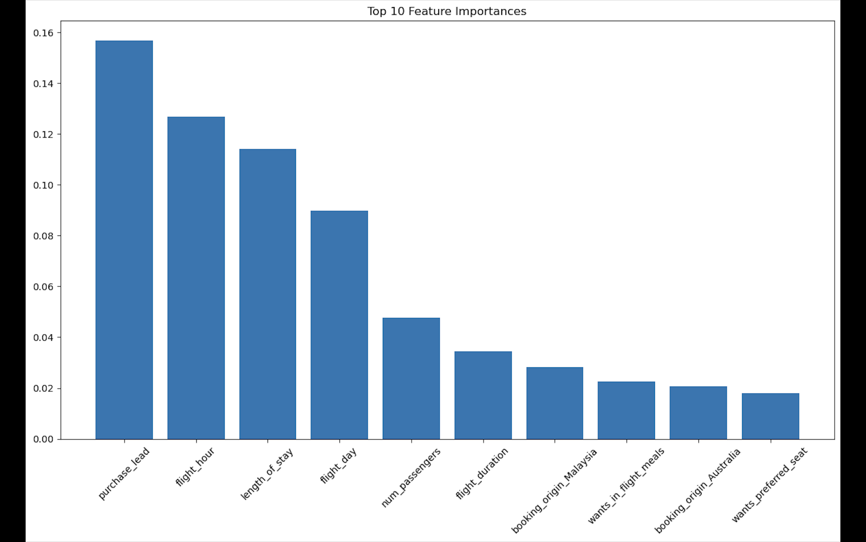
Top 10 Features : Visualisation

Slide 7
Conclusion
Top Features Contributing to Booking Predictions: -
Purchase Lead
Flight Hour
Length of Stay

